Slide 1
A SOFTWARE RELIABILITY MODEL CONSIDERING ERROR GENERATION , FAULT REMOVAL EFFICIENCY AND TESTING COVERAGE
BY
BASRAH YOUSUF

Slide 2
INTRODUCTION
Software reliability is the likelihood of the failure free function of a software in a given period of time under certain circumstances.
Software testing is the key activity for determining and removing faults and consequently improving reliability of a software.
Testing coverage measures quantify the degree of thoroughness of testing.
Software reliability growth models (SRGM) are the mathematical functions that estimate the reliability of a software.
Proposed model is based on NHPP.

Slide 3
PROPOSED MODEL
The proposed model is based on the following assumptions:
Software faults’ occurrence and removal follow NHPP.
The software failure rate at any time is a function of fault detection rate and the number of faults remaining in the software at that time.
The fault detection rate can be expressed by;
c’(t)/1-c(t)
c(t) =the percentage of the code that has been examined up to time t
c’ (t) =the derivative of the testing coverage function.
When a software failure is detected, an immediate debugging starts, and either;

Slide 4
PROPOSED MODEL
the total number of faults is reduced by one with probability p, or
the total number of faults remains the same with probability 1-p.
During the fault repair process, whether the fault is removed completely or not, new faults are introduced with a probability constant alpha.
MODEL DEVELOPMENT
Consider c(t) the percentage of the code that has been covered up to time t.
c(t) is an increasing function of testing time t and after the software turns stable it becomes flat at the tail.
Thus, the function c ‘(t)/(1-c(t)) is used to denote the fault detection rate which has been taken as the common assumption by SRGMs considering testing coverage.

Slide 5
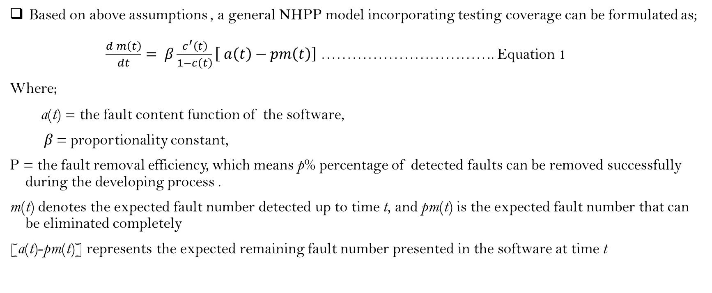
PROPOSED MODEL
Based on above assumptions , a general NHPP model incorporating testing coverage can be formulated as;
$\frac{d m\left(t\right)}{dt}= β\frac{c^{′}\left(t\right)}{1−c\left(t\right)}\left[ a\left(t\right)−pm\left(t\right)\right]$ ……………………………. Equation 1
Where;
a(t) = the fault content function of the software,
β = proportionality constant,
P = the fault removal efficiency, which means p% percentage of detected faults can be removed successfully during the developing process .
m(t) denotes the expected fault number detected up to time t, and pm(t) is the expected fault number that can be eliminated completely
[a(t)-pm(t)] represents the expected remaining fault number presented in the software at time t

Slide 6
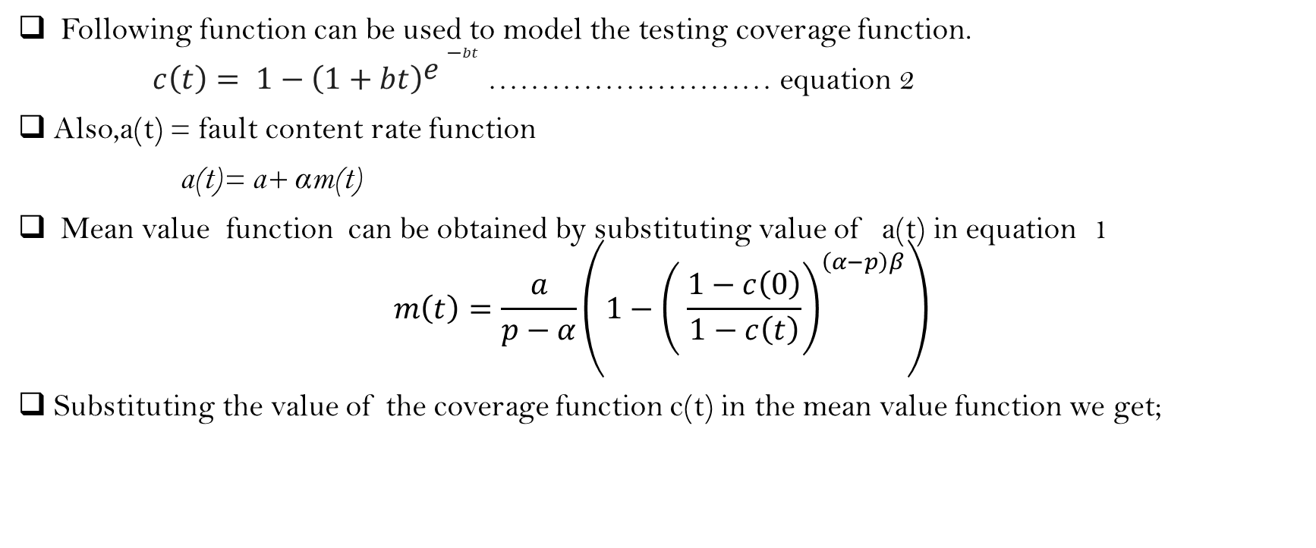
PROPOSED MODEL
Following function can be used to model the testing coverage function.
$c\left(t\right)= 1−\left(1+bt\right){e−}^{bt}\text{……………………… }\text{equation}\text{ 2}$
Also,a(t) = fault content rate function
a(t)= a+ αm(t)
Mean value function can be obtained by substituting value of a(t) in equation 1
$$m\left(t\right)=\frac{a}{p−α}\left.\left(1−{\left.\left( \frac{1−c\left(0\right)}{1−c\left(t\right)}\right.\right)}^{\left(α−p\right)β}\right.\right)$$
Substituting the value of the coverage function c(t) in the mean value function we get;

Slide 7
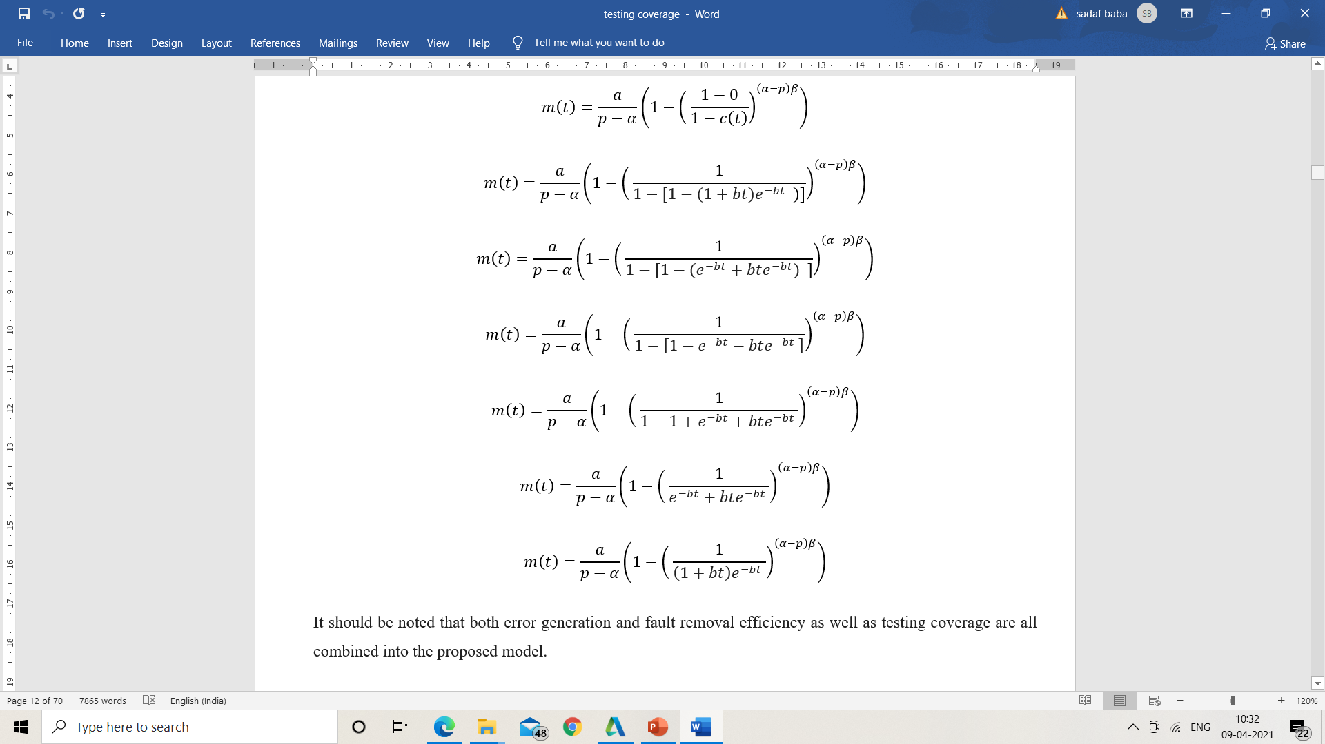
PROPOSED MODEL

Slide 8
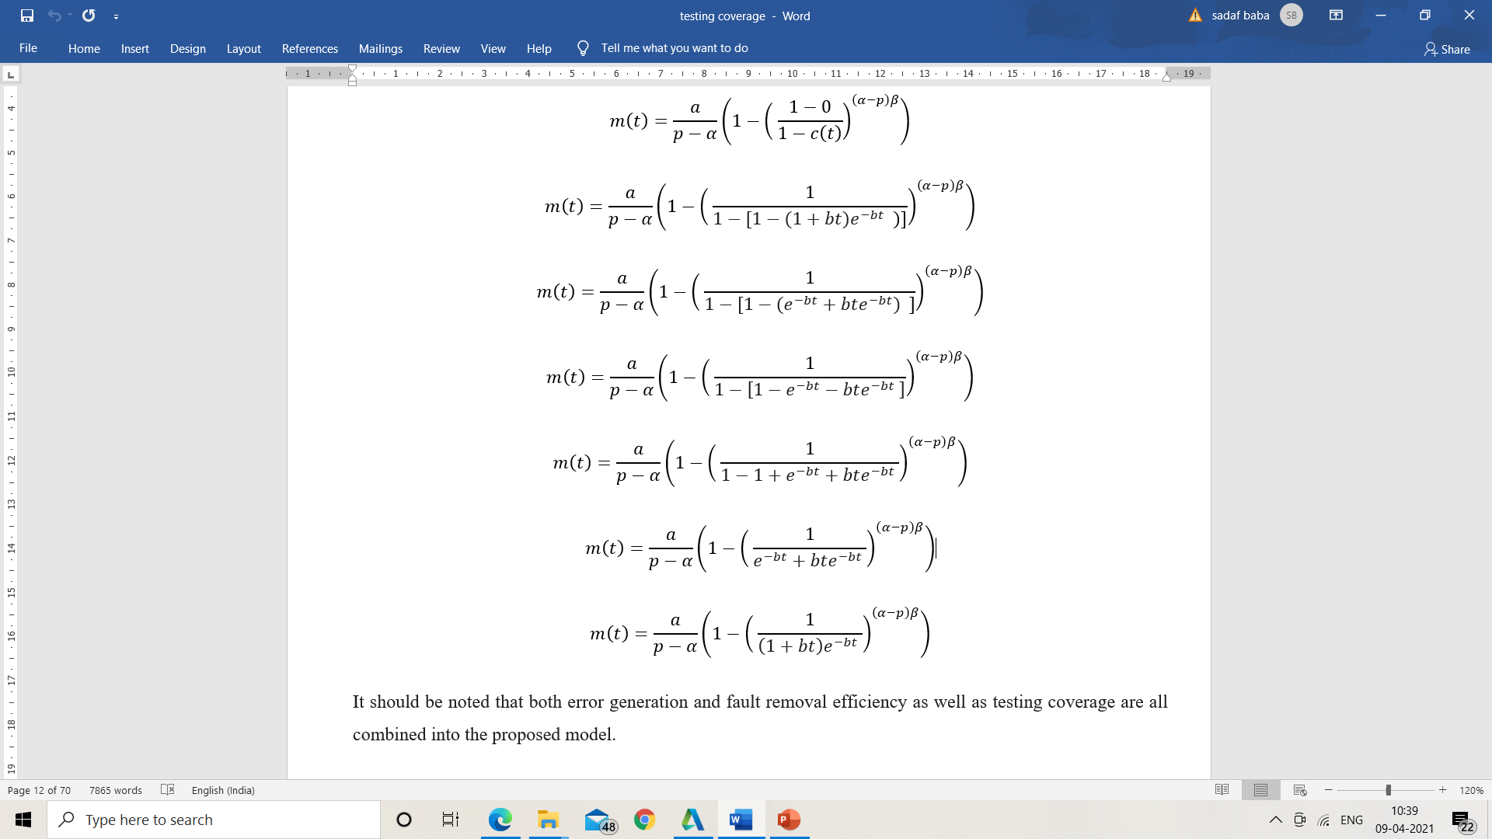
PROPOSED MODEL
Therefore, the mean value function for the proposed model is;
It should be noted that error generation and fault removal efficiency as well as testing coverage are all combined into the proposed model.

Slide 9
RESULTS
ESTIMATION METHOD : LEVENBERG MARQUADT ALGO.
PERFORMANCE CRITERIA:
1. R Squared measure
2. MSE measure
3. Adjusted R square
DATA SET : Failure data sets from NASA

Slide 10
